Slide 1
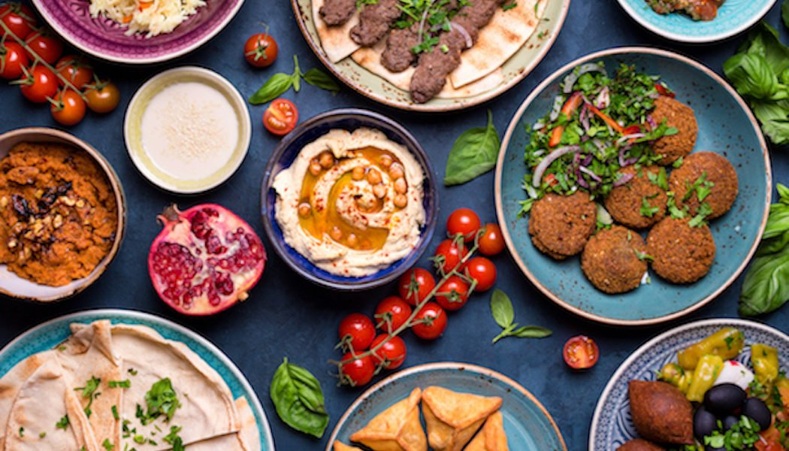
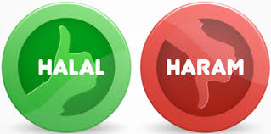
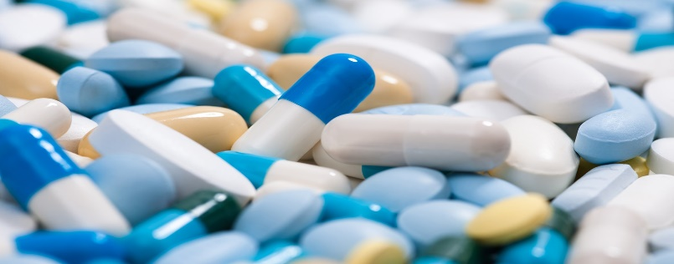
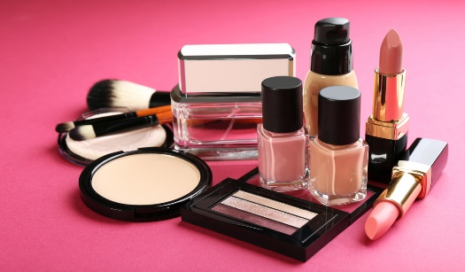
Impact of Covid-19 on Halal Industry
Prof. Dr. Faqir Muhammad Anjum
Vice Chancellor
University of the Gambia,
Gambia
Email: vc@utg.edu.gm

Slide 2
HALAL PRODUCTS
HALAL Products includes both Food & Non Food Items
Food Products
Meat and poultry products
Confectionery
Canned & Frozen Food
Dairy Produce
Bakery Products
Organic Food
Beverages

Slide 3
Halal Food
Halal food must be clean and pure and made in accordance with the Islamic guidelines, which include prohibition of pork and pork by-products, blood and blood by-products, animals where the name of Allah has not been invoked during slaughter, animals which have not been slaughtered or dead before slaughtering, carnivorous animals and items intoxicant containing alcohol

Slide 4
Halal Food Products
Halal food has mainly three types which include,
Fresh products.
Frozen salty products.
Processed products.
With large number of Islamic population and economy development the consumers will need more halal food products.

Slide 5
In consumption market, the global consumption value of halal food increases with the 8.14% average growth rate.
East Asia and Middle East and North Africa are the mainly consumption regions due to the bigger demand of downstream applications.
In 2015, these two regions occupied 56.83% of the global consumption volume in total.

Slide 6
The major raw materials for halal food are:
Fresh meat ,food seasoning ,packing materials and other additives.
Fluctuations in the price of the upstream product will impact on the production cost of halal food and then impact the price of halal food.
The production cost of halal food is also an important factor which could impact the price of halal food.

Slide 7
The halal food manufacturers are trying to reduce production cost by developing production method
The global Halal Food market is valued at 1140 million USD in 2018 and will reach 1590 million USD by the end of 2025, growing at a CAGR of 4.3% during 2019-2025.

Slide 8
The core opportunity is about halal newcomers challenging today’s global leaders in the food and beverage industry.
The halal food industry is set for rapid growth and could exceed a US$1 trillion industry by 2020, it will give rise to new companies challenging existing multinationals for market share

Slide 9
Risk of Cross-Contamination
Halal food supply chain has been exposed with many risks that would affect the halal food supply chain integrity.
One of the risks is cross-contamination between halal and non-halal food products.
Cross-contamination occurs when halal food product has a direct contact with non-halal food or non food product .

Slide 10
Food is considered halal or haram by looking at the whole food chain.
The risks involved in halal supply chain will increase the possibility of the food products turned from halal to haram

Slide 11
CHALLENGES IN INTERNATIONAL TRADE OF HALAL FOOD PRODUCTS
First, is the fact that most of the current importing countries still rely on non-tradable food products that are largely supplied domestically.
Second, in the case of high tradable products, such as in the GCC countries, reliance on the Halal status alone simply cannot work. Halal products are already becoming mainstream products. Being Halal is necessary, but not a sufficient condition.

Slide 12
Third, as Halal products are universal products, the packaging and labelling must represent world-class standard. Most Halal products in the export markets failed due to poor packaging, poor product adaptability to suit the local taste requirement and lack of branding exercise
Brand awareness and loyalty must be built gradually and it cannot be achieved in a day. when it is gained, the pay-offs will be great.

Slide 13
Forth halal markets are not similar to other markets everywhere. Each is a fragmented market by ethnicity, location, income and a few other determinants. Therefore, a one-size-fits-all strategy simply cannot work. Product adaptability in each target market needs to be considered seriously. As with the case of other food products, consumer requirements may differ across the region.

Slide 14
HALAL PRODUCTS
HALAL Products also includes Non-Food products such as:
Pharmaceuticals
Cosmetics & Beauty products
Personal Care & Body Care Products
Nutraceuticals & Supplements

Slide 15
Global halal Industry
Halal trade is estimated to be around 3 Trillion USD a year
Expected to reach 4 Trillion USD by 2022
UN statistics recorded yearly growth of Muslims at around 6.4% compared to 1.46% for Christianity
1 in 5 persons in this world is a Muslim by birth or geography
80% of the global halal supplier base of Food & Non-Food products
Non-Muslim countries
Notes:
Research shows that 80%.... According to the same statistics,

Slide 16
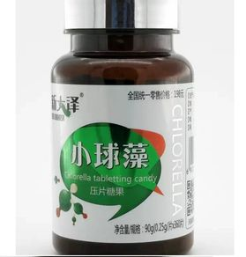
Halal Pharmaceuticals
Pharmaceutical and health products are also large growth areas in the global halal industries
Demand for
halal pharmaceutical
healthcare products
USD555 billion in Muslim-majority countries

Slide 17
Cont..
Global market growth for pharmaceuticals increased by 4% to a value that exceeded USD 820 billion
Major concerns among the Muslims is the use of non-compliant substances such as animal derivatives and animal-based gelatines in these products
Notes:
The main concern among

Slide 18
There are approximately 1.6 billion Muslims in the world which is almost one quarter of the world population.
By increasing the Muslim population, the awareness on halal pharmaceuticals has also been increased
Now-a-days, halal products are not only focused on food but all the products including pharmaceuticals.

Slide 19
Halal pharmaceuticals are drug products that are derived from a permissible source i.e., animals, plants,
Halal pharmaceutical products should not only be free from Haram constituents but they should also be Tayyib.
The term Tayyib refers to a good or product that is clean, pure and produced based on standard processes and procedures.

Slide 20
The main prohibited material in Medicine in Arabia is Khamar in medicine (Alcoholic drinks).
Ethanol is the most abundantly used liquid that serves as stabilizer for liquid form of medicine and also as a solvent in extraction process for pharmaceutical products.
Alcoholic compounds are generally allowed with the conditions that it is not derived from khamar.

Slide 21
Halal Cosmetics
Growth in the halal cosmetics industry is reflected by a growth in consumer knowledge
Ingredients used
Product awareness
Global halal cosmetic industry is estimated at USD16.32 billion with an annual growth rate of 12%
At present the halal cosmetic market constitutes 11% of the total global halal industry

Slide 22
Halal cosmetic products are gaining awareness and increasing demand among the 2.4 billion Muslim consumers worldwide.
The global halal market is anticipated to expand at a compound annual growth rate of 6.8% until 2024.
Halal cosmetics carry a wider market appeal among non-Muslim consumers, who attribute these products with ethical consumerism and more stringent quality assurance standards.

Slide 23
Halal cosmetic products must not contain ingredients derived from pig, blood, human body parts, reptiles, and insects among others.
Cosmetic ingredients derived from permissible animals must be slaughtered according to Islamic law to be considered halal.
The intent of certifying products as halal is parallel with the goals of most quality assurance procedures (e.g., cGMP, HACCP)

Slide 24
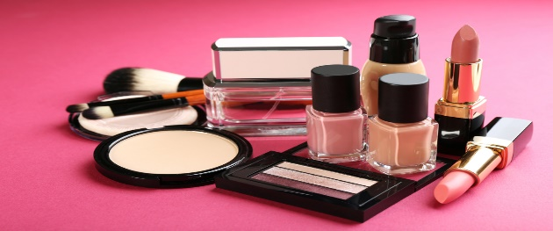
Cont…
Cosmetics and personal care products are part of our daily lives
These include :
Baby products
Skin care products
Personal hygiene products
Perfumes
Deodorants
Makeup

Slide 25
Cont..
Some products meet the definitions
Cosmetics
Drugs
When a product has two intended uses
Shampoo is a cosmetic because its intended use is to clean hair
An anti-dandruff treatment is a drug because its intended use is the treatment of dandruff

Slide 26
Ingredients in halal cosmetics
Cosmetics and personal care products
Majority of these products include botanical ingredients
These ingredients are all fatty alcohols and occur naturally in small quantities in plants and animals
Cetyl Alcohol
Cetearyl Alcohol
Myristyl Alcohol
Behenyl Alcohol
White, waxy solids, not related to ethyl alcohol
Notes:
These are used as emulsifier, water and oil emulsions in cosmetics and personal care products.

Slide 27
Commonly used in cosmetics and personal care products
Especially in skin lotions and creams
Dimethicone and Methicone
Silicone based polymers, are also considered halal
Used as anti-foaming agents or skin conditioning agents

Slide 28
Collagen is used in many personal care products such as skin care and anti-aging creams
It is made from animal hides including pigs and may be labelled as hydrolysed animal protein
Products containing collagen and hydrolysed animal protein must be avoided

Slide 29
Health Products
Multivitamins and nutritional supplements are not usually taken due to serious illness, but rather to improve health.
The guidelines for manufacture of halal nutritional supplements are the same as for those of other food products when it comes to those made up of botanicals and plant extracts.

Slide 30
For instance, companies commonly use gelatin to make soft gel and hard shell capsules.
Tablets may be coated with gelatin. Gelatin made of modified starch, cellulose gum, etc., and are acceptable to halal standards.
Gelatin made from pork, however, is not. Many liquids may contain alcohol as a preservative, which is also unacceptable.

Slide 31
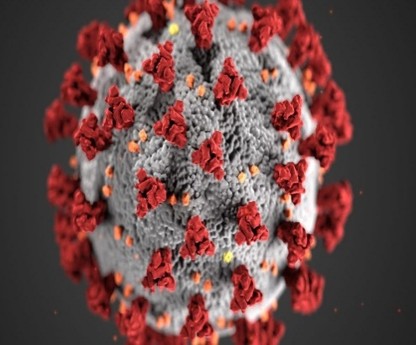
Impact of Covid-19 on Halal Industry
COVID-19 affect the global economy in three main ways:
By directly affecting production and demand
Creating supply chain and market disruption
Financial impact on firms and financial markets.

Slide 32
Due to COVID -19 Impact on Halal Food Market is expected to grow with the CAGR of 4.2% by 2027
The impact of the novel COVID-19 pandemic on the Halal Food market and offers a clear assessment of the projected market fluctuations during the forecast period.

Slide 33
The different factors that are likely to impact the overall dynamics situation of the Halal Food market over the forecast period (2019-2029) including the current trends, growth opportunities, restraining factors.

Slide 34
Halal Food Market production, market share and growth rate for each company and also covers the breakdown data (production, consumption, revenue and market share) by regions, type and applications.
Halal Food history breakdown data from 2014 to 2018, and forecast to 2025.

Slide 35
The impact of COVID-19 on supply chain. Because of the unprecedented measures being taken in the US and globally to attempt to limit spread of the virus
There have been significant disruptions to supply chains around the world. This can be particularly critical if you have been using a sole-source supplier in an area of highest outbreak.

Slide 36
The supply chain is significant for the food industry, particularly the hidden dangers of having to rush into sourcing from other places that you may not have time to fully assess; the difficulty in getting product from overextended suppliers; the lack of ingredients that come only from a single high-outbreak area; and even travel to inspect a provider’s facility or bring on a new supplier.

Slide 37
The outbreak of COVID-19 has brought effects on many aspects,
Like flight cancellations , travel bans and quarantines restaurants closed; all indoor events restricted; over forty countries state of emergency declared; massive slowing of the supply chain; stock market volatility; falling business confidence, growing panic among the population, and uncertainty about future.

